Slide 1


Food Waste Reduction Application
Presented by:
1) Apurva Kulkarni
3) Afrin Shaikh
2) Saurabh Rajpoot
4) Shruti Maliye

Slide 2

Presentation Outline
1 2 3 4 5 6
Objectives
Introduction of our project concepts
Features of Project
System/User Requirement
Future Scope
Conclusion

Slide 3



1) Objectives
The ultimate objective of this project is to communicate that investments in food wastage reduction is the most logical step in the pursuit of sustainable production and consumption, including food security, environmental effects.
Public awareness materials and a strategy will be developed to this effect.

Slide 4

2) Concept
In existing system if anyone have extra food because of any function or in their home it will be become waste because instantly there is no way to share with anyone if they are having lots of food.
Even if they want to give that extra food to any orphanage or poor people they don’t have time or don’t have an idea about that.
So that we have create a application for sponsor that extra food to poor people or nearby orphanage.

Slide 5
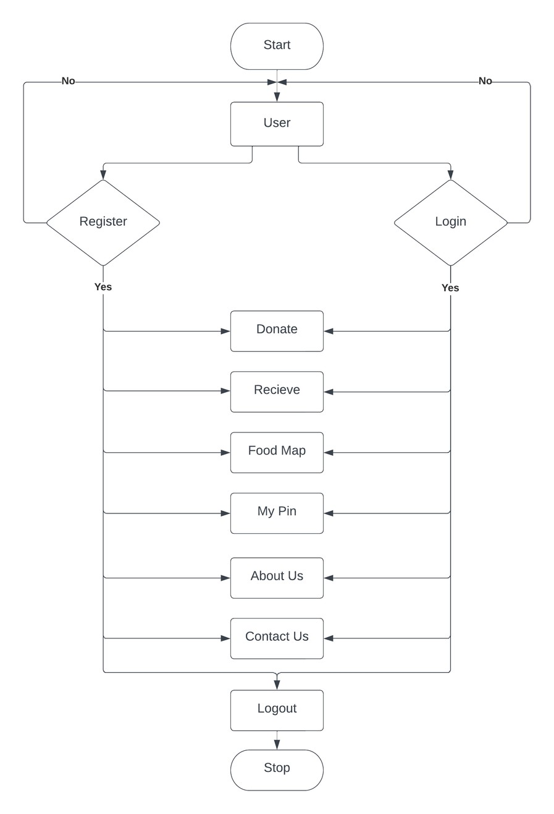
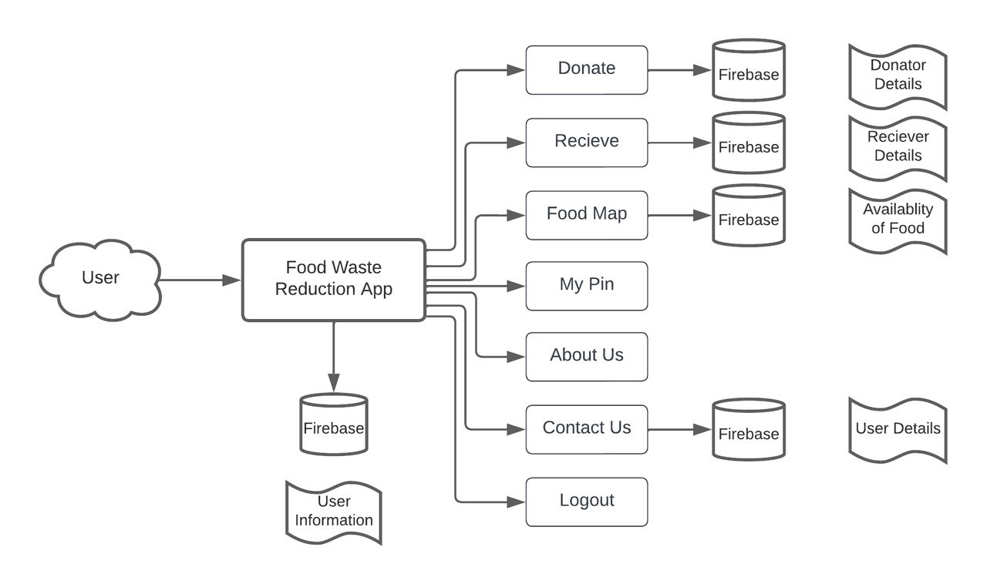
System Design
Flowchart

Slide 6


3) Feature of Project
1. Login
Donate
Receive
Food Map
My Pins
History
About Us
Contact Us
Logout
Register
About Us
Developed By

Slide 7

4) System/User Requirement
Hardware requirement :
System: Pentium IV 2.4 GHz.
Hard Disk : 40 GB.
Ram: 8 GB.
Software requirement :
Operating system : Windows 10
Coding Language: Xml, Java.
IDE : Android Studio.
Front End: Xml.
Back End: Firebase

Slide 8


5) Future Scope
1.In future work, there was no standard food information system on food packages that gives the user the information of both the name of the food, as well as its expiry date.
The viable improvement would be get the food name from the product bar code and read the expiry date using OCR tools.
However, the level of ease of using this option is only slightly greater than using the manual option of filling the food information

Slide 9

6) Conclusion
The proposed application shall reduce food wastage and also fulfill other requirements like clothes, books, utensils, etc. of needy organizations.
As mentioned above in the description there is a lot of food wastage that occurs daily at restaurants and cafes.
Instead of throwing away the same as trash (which usually is the scenario), it can be used to feed the homeless.
Also, since the pickup is arranged for by the enterprise, the restaurants/cafes need not worry about it.
Benefiters will be both the restaurants/cafes (reducing the carbon footprint and wastage), and the needy

Slide 10


Thank you for listening!
Don't hesitate to ask any questions!

